Slide 1
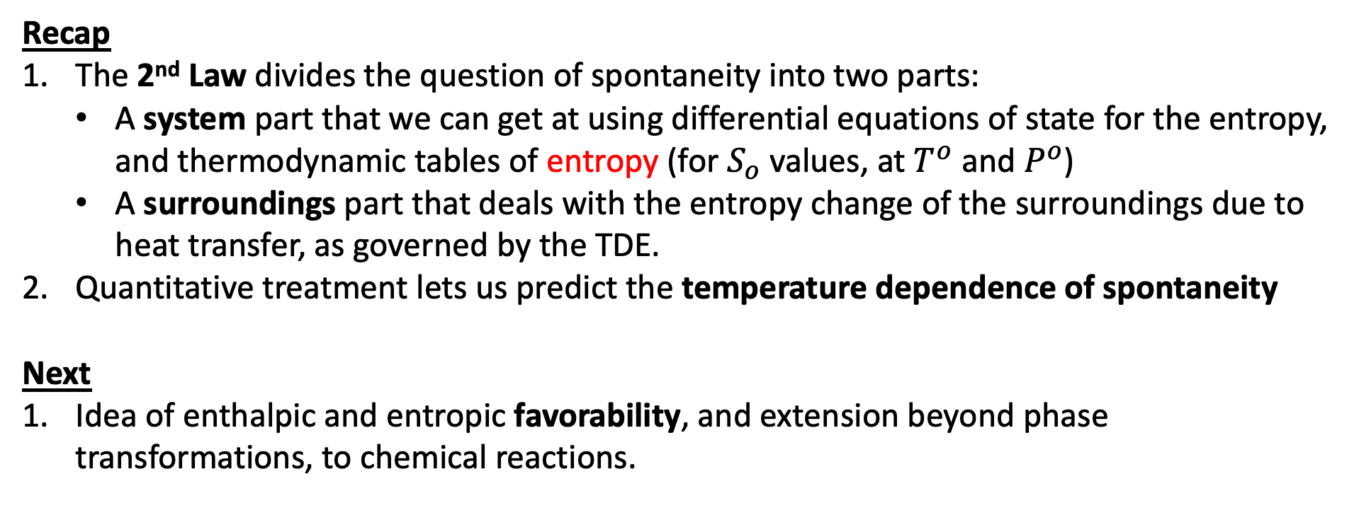
Scope of today’s work
Recap
The 2nd Law divides the question of spontaneity into two parts:
A system part that we can get at using differential equations of state for the entropy, and thermodynamic tables of entropy (for $S_{o}$ values, at $T^{o}$ and $P^{o}$)
A surroundings part that deals with the entropy change of the surroundings due to heat transfer, as governed by the TDE.
Quantitative treatment lets us predict the temperature dependence of spontaneity
Next
Idea of enthalpic and entropic favorability, and extension beyond phase transformations, to chemical reactions.

Slide 2
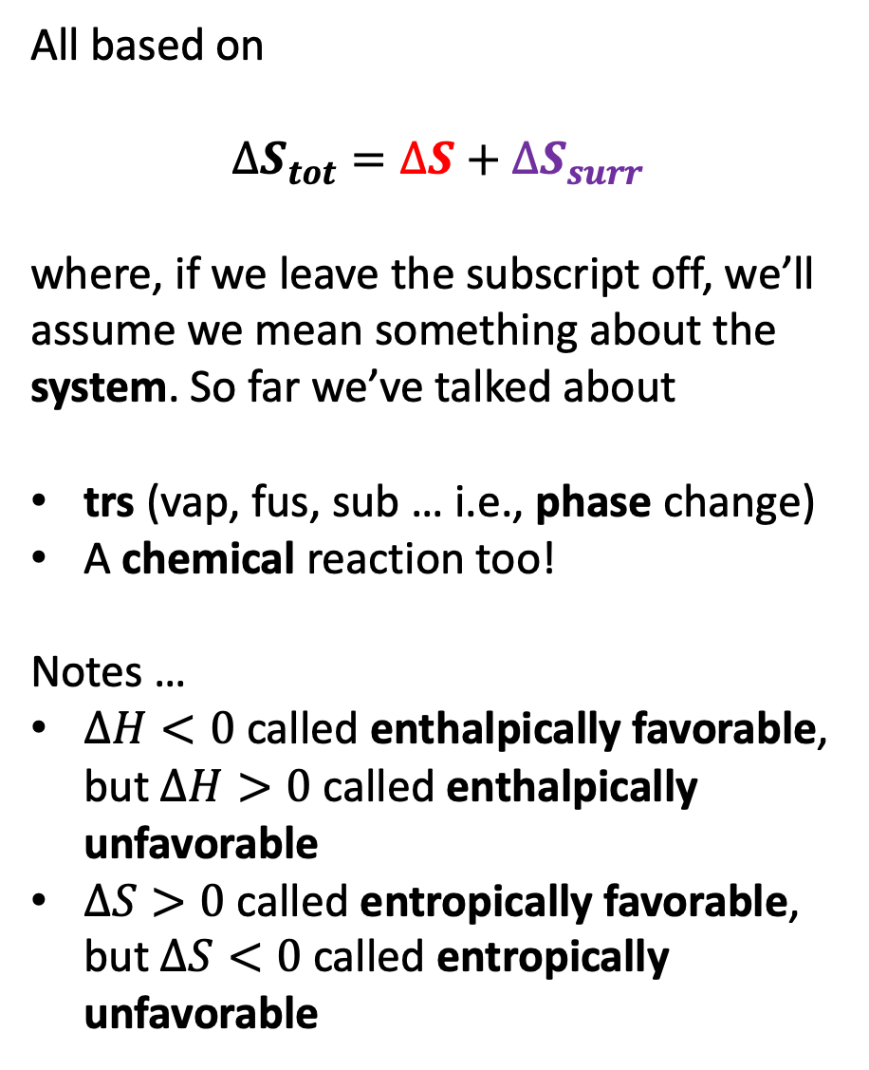
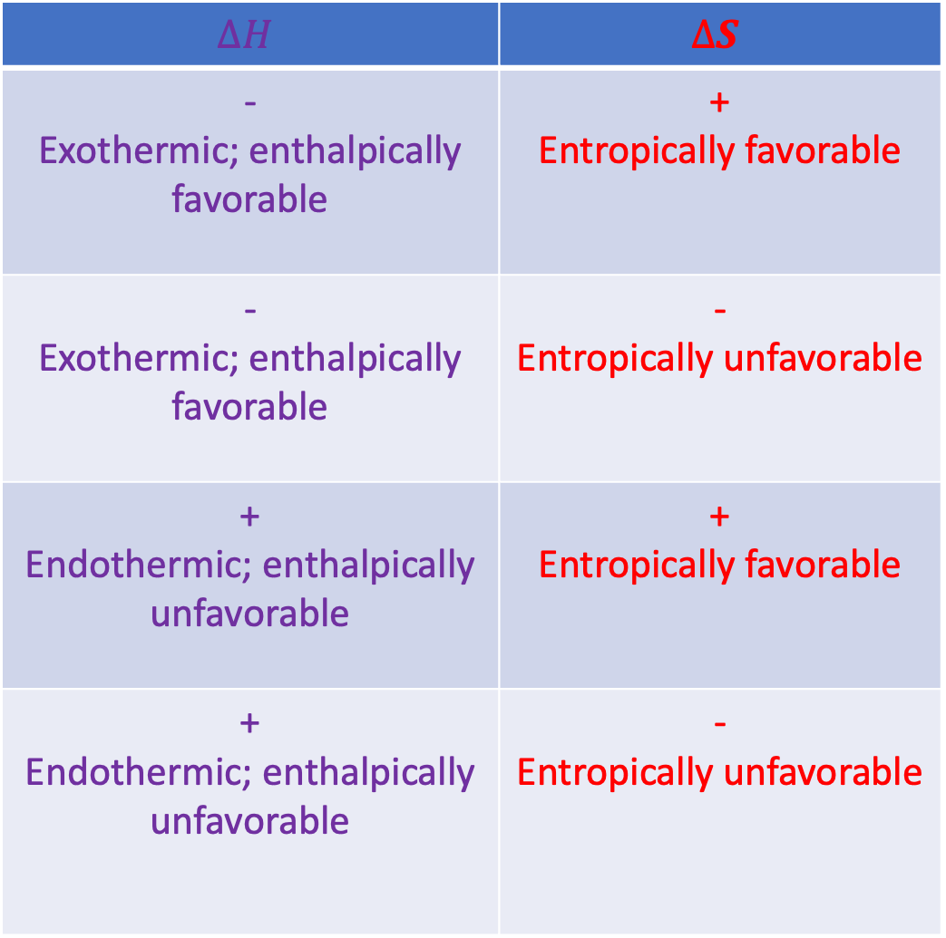
Generalizing and systematizing
All based on
$$∆S_{tot}=∆S+∆S_{surr}$$
where, if we leave the subscript off, we’ll assume we mean something about the system. So far we’ve talked about
trs (vap, fus, sub … i.e., phase change)
A chemical reaction too!
Notes …
$∆H<0$ called enthalpically favorable, but $∆H>0$ called enthalpically unfavorable
$∆S>0$ called entropically favorable, but $∆S<0$ called entropically unfavorable
$$∆H$$ | $$∆S$$
- Exothermic; enthalpically favorable | + Entropically favorable
- Exothermic; enthalpically favorable | - Entropically unfavorable
+ Endothermic; enthalpically unfavorable | + Entropically favorable
+ Endothermic; enthalpically unfavorable | - Entropically unfavorable

Slide 3
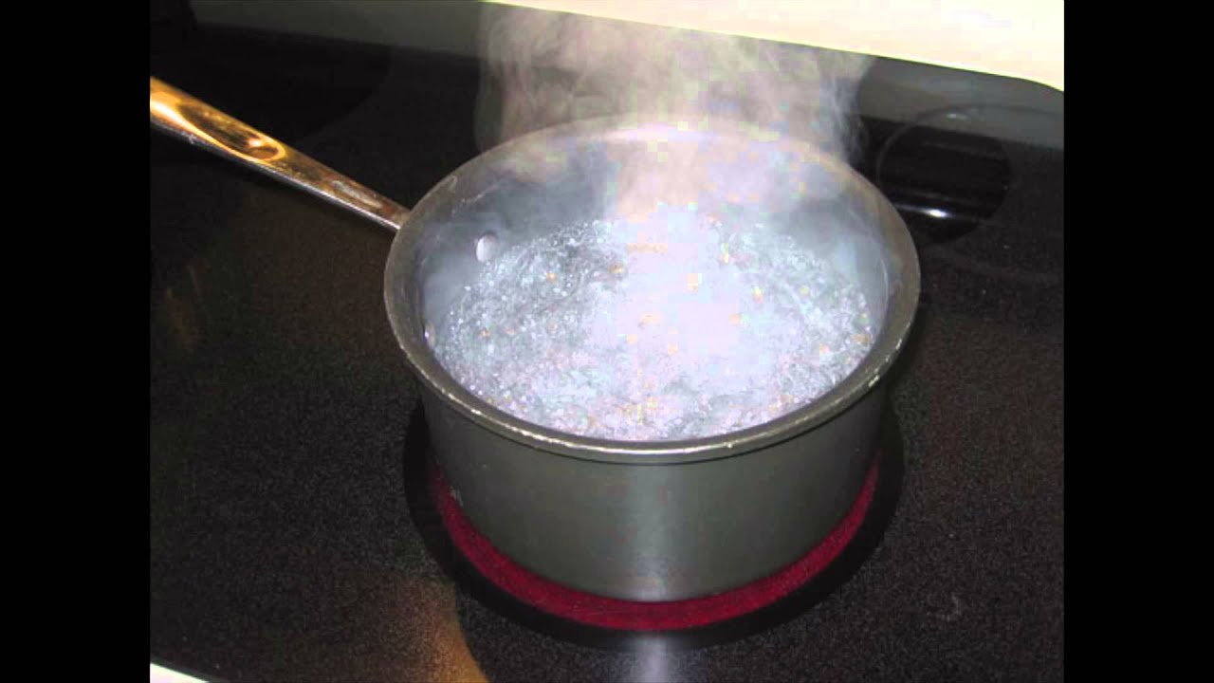

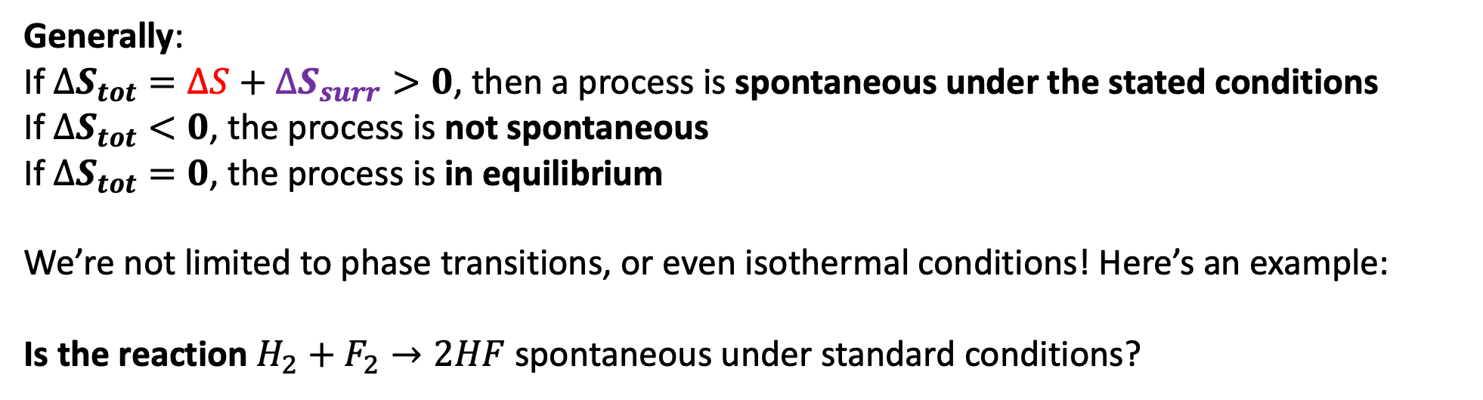
A more general statement of the 2nd Law of thermodynamics
Generally:
If $∆S_{tot}=∆S+∆S_{surr}>0$, then a process is spontaneous under the stated conditions
If $∆S_{tot}<0$, the process is not spontaneous
If $∆S_{tot}=0$, the process is in equilibrium
We’re not limited to phase transitions, or even isothermal conditions! Here’s an example:
Is the reaction $H_{2}+F_{2}→2HF$ spontaneous under standard conditions?
-$109$

Slide 4
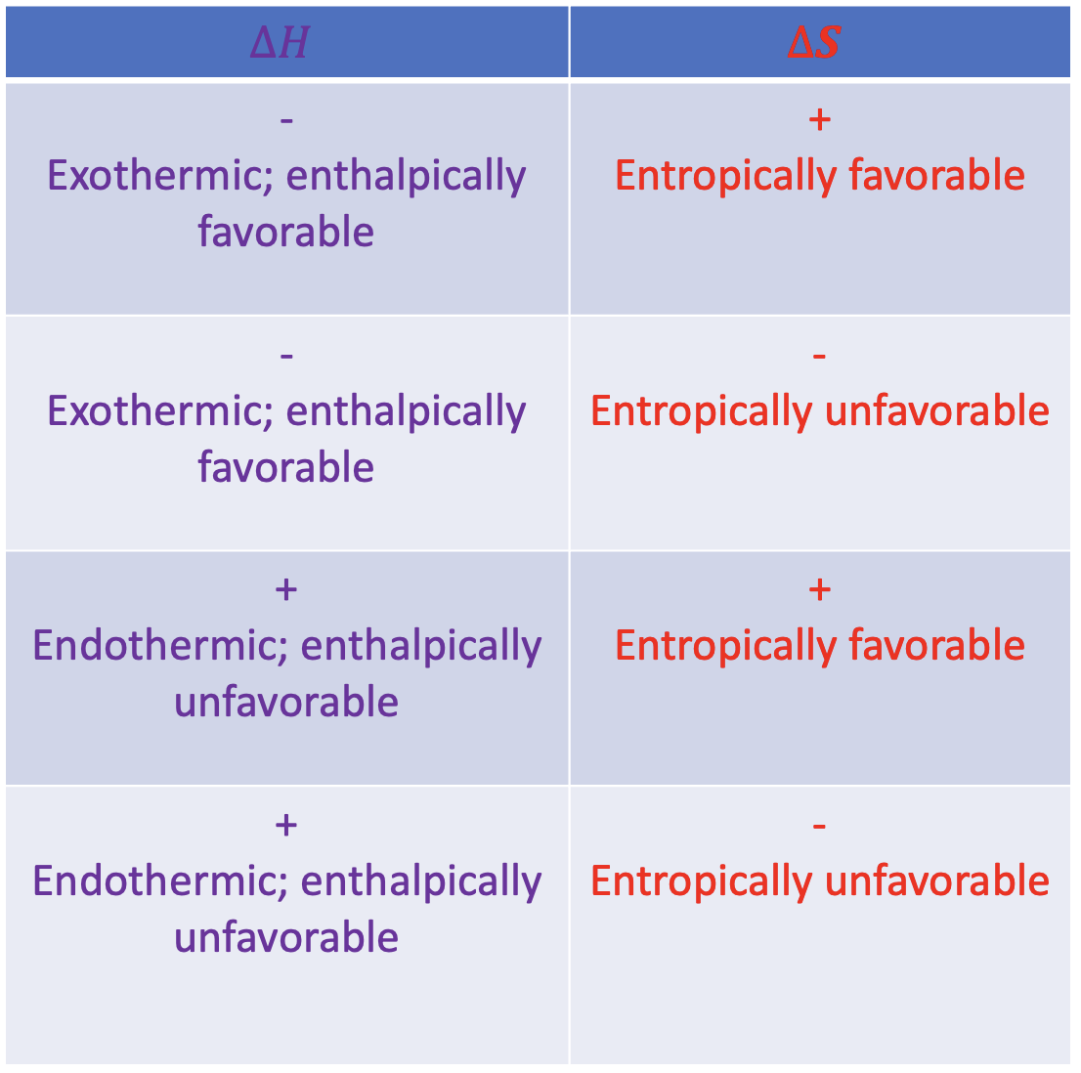
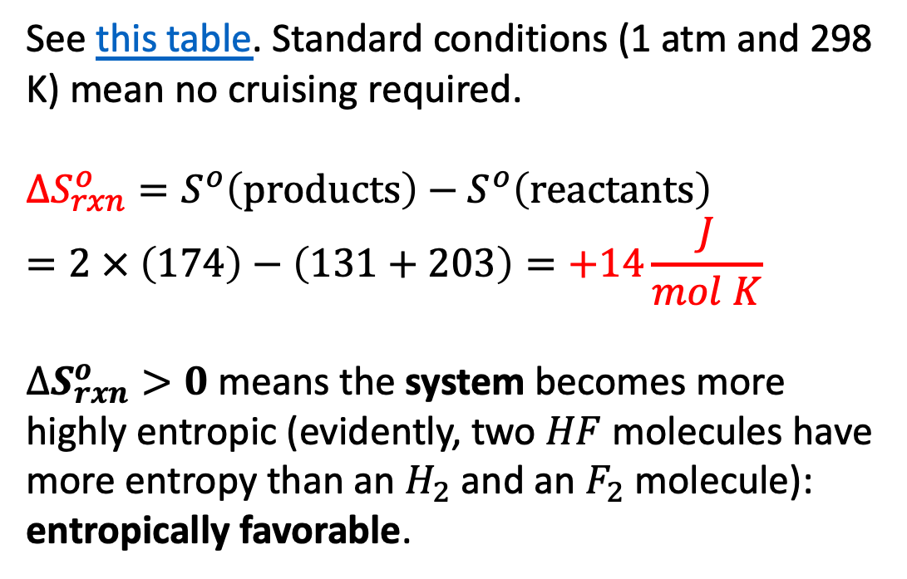
Thermodynamics of the reaction $H_{2}+F_{2}→2HF$
See this table. Standard conditions (1 atm and 298 K) mean no cruising required.
$$∆S_{rxn}^{o}=S^{o}\left(products\right)−S^{o}\left(reactants\right)=2 × \left(174\right)−\left(131+203\right)=+14\frac{J}{mol K}$$
$∆S_{rxn}^{o}>0$ means the system becomes more highly entropic (evidently, two $HF$ molecules have more entropy than an $H_{2}$ and an $F_{2}$ molecule): entropically favorable.

Slide 5

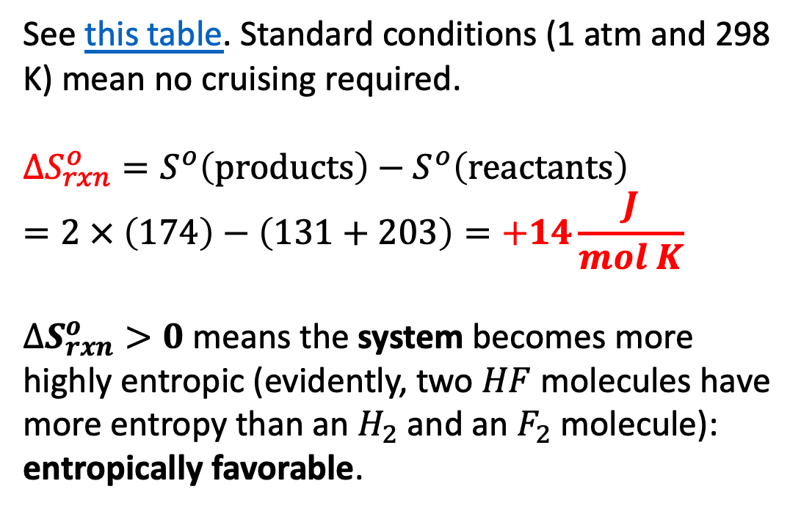
Thermodynamics of the reaction $H_{2}+F_{2}→2HF$
See this table. Standard conditions (1 atm and 298 K) mean no cruising required.
$$∆S_{rxn}^{o}=S^{o}\left(products\right)−S^{o}\left(reactants\right)=2 × \left(174\right)−\left(131+203\right)=+14\frac{J}{mol K}$$
$∆S_{rxn}^{o}>0$ means the system becomes more highly entropic (evidently, two $HF$ molecules have more entropy than an $H_{2}$ and an $F_{2}$ molecule): entropically favorable.
$$14\frac{J}{mol K}$$
$$14\frac{J}{mol K}$$

Slide 6
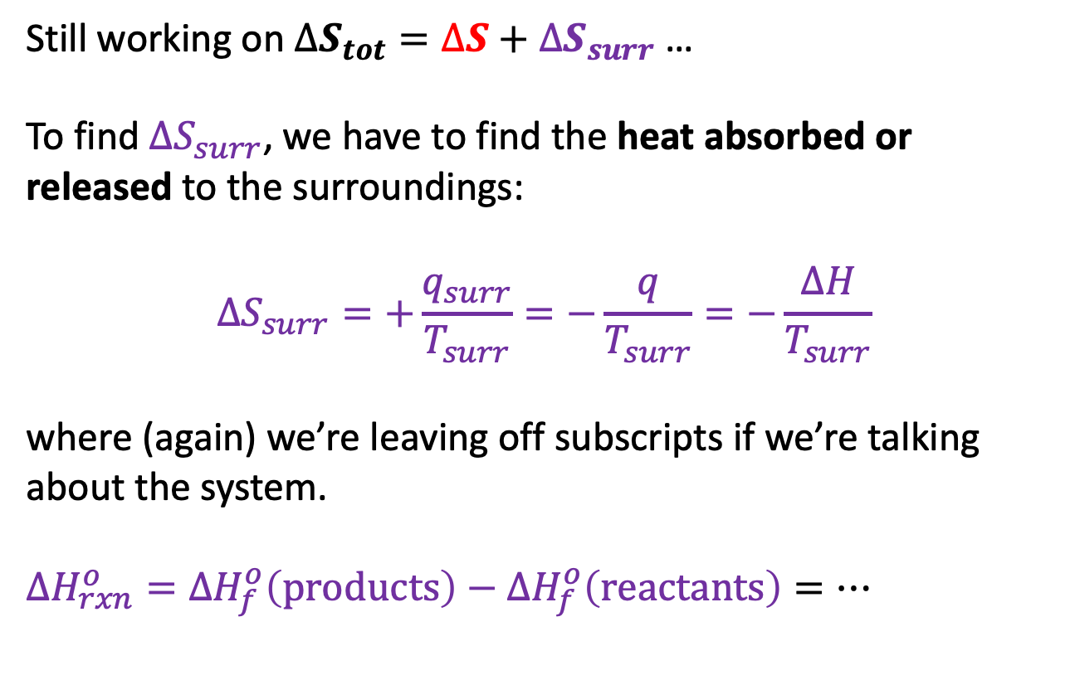
Thermodynamics of the reaction $H_{2}+F_{2}→2HF$
Still working on $∆S_{tot}=∆S+∆S_{surr}$ …
To find $∆S_{surr}$, we have to find the heat absorbed or released to the surroundings:
$$∆S_{surr}=+\frac{q_{surr}}{T_{surr}}=−\frac{q}{T_{surr}}=−\frac{∆H}{T_{surr}}$$
where (again) we’re leaving off subscripts if we’re talking about the system.
$∆H_{rxn}^{o}={∆H}_{f}^{o}\left(products\right)−{∆H}_{f}^{o}\left(reactants\right)=…$

Slide 7
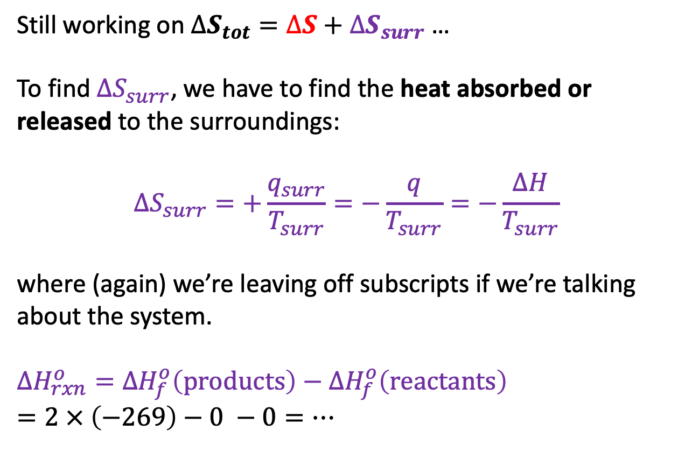
Thermodynamics of the reaction $H_{2}+F_{2}→2HF$
Still working on $∆S_{tot}=∆S+∆S_{surr}$ …
To find $∆S_{surr}$, we have to find the heat absorbed or released to the surroundings:
$$∆S_{surr}=+\frac{q_{surr}}{T_{surr}}=−\frac{q}{T_{surr}}=−\frac{∆H}{T_{surr}}$$
where (again) we’re leaving off subscripts if we’re talking about the system.
$∆H_{rxn}^{o}={∆H}_{f}^{o}\left(products\right)−{∆H}_{f}^{o}\left(reactants\right)$
$=2 × \left(−269\right)−0 −0=…$

Slide 8
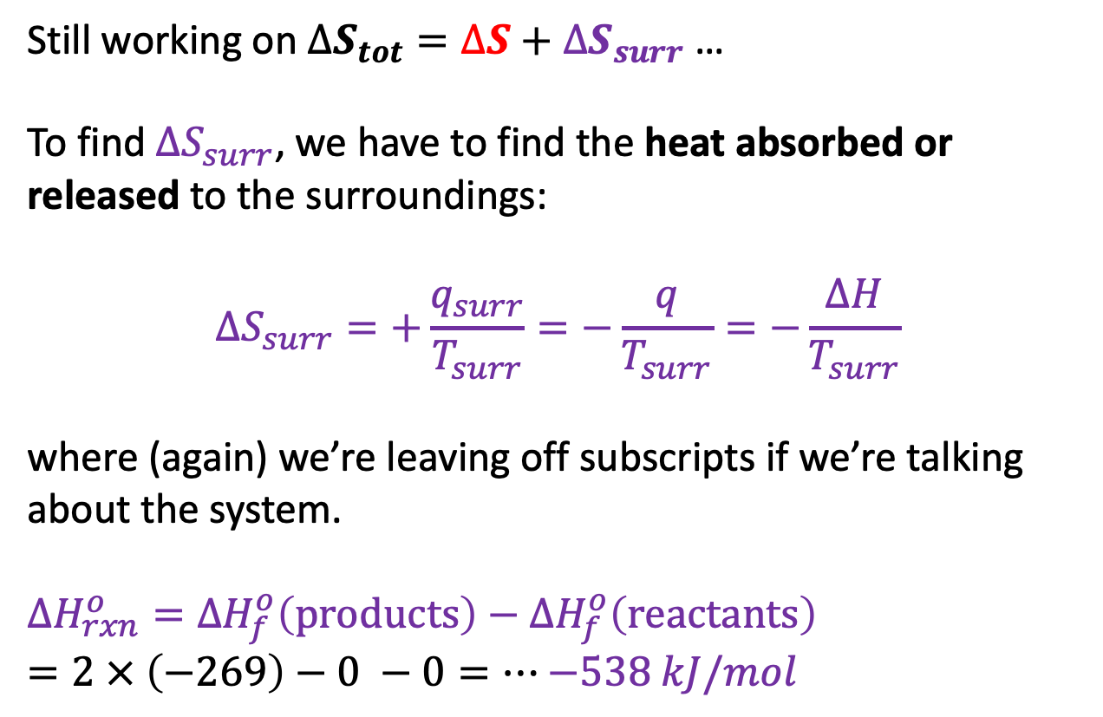
Thermodynamics of the reaction $H_{2}+F_{2}→2HF$
Still working on $∆S_{tot}=∆S+∆S_{surr}$ …
To find $∆S_{surr}$, we have to find the heat absorbed or released to the surroundings:
$$∆S_{surr}=+\frac{q_{surr}}{T_{surr}}=−\frac{q}{T_{surr}}=−\frac{∆H}{T_{surr}}$$
where (again) we’re leaving off subscripts if we’re talking about the system.
$∆H_{rxn}^{o}={∆H}_{f}^{o}\left(products\right)−{∆H}_{f}^{o}\left(reactants\right)$
$=2 × \left(−269\right)−0 −0=…$ $−538 kJ/mol$

Slide 9
Thermodynamics of the reaction $H_{2}+F_{2}→2HF$
Still working on $∆S_{tot}=∆S+∆S_{surr}$ …
To find $∆S_{surr}$, we have to find the heat absorbed or released to the surroundings:
$$∆S_{surr}=+\frac{q_{surr}}{T_{surr}}=−\frac{q}{T_{surr}}=−\frac{∆H}{T_{surr}}$$
where (again) we’re leaving off subscripts if we’re talking about the system.
$∆H_{rxn}^{o}={∆H}_{f}^{o}\left(products\right)−{∆H}_{f}^{o}\left(reactants\right)$
$=2 × \left(−269\right)−0 −0=…$ $−538 kJ/mol$
$$14\frac{J}{mol K}$$

Slide 10
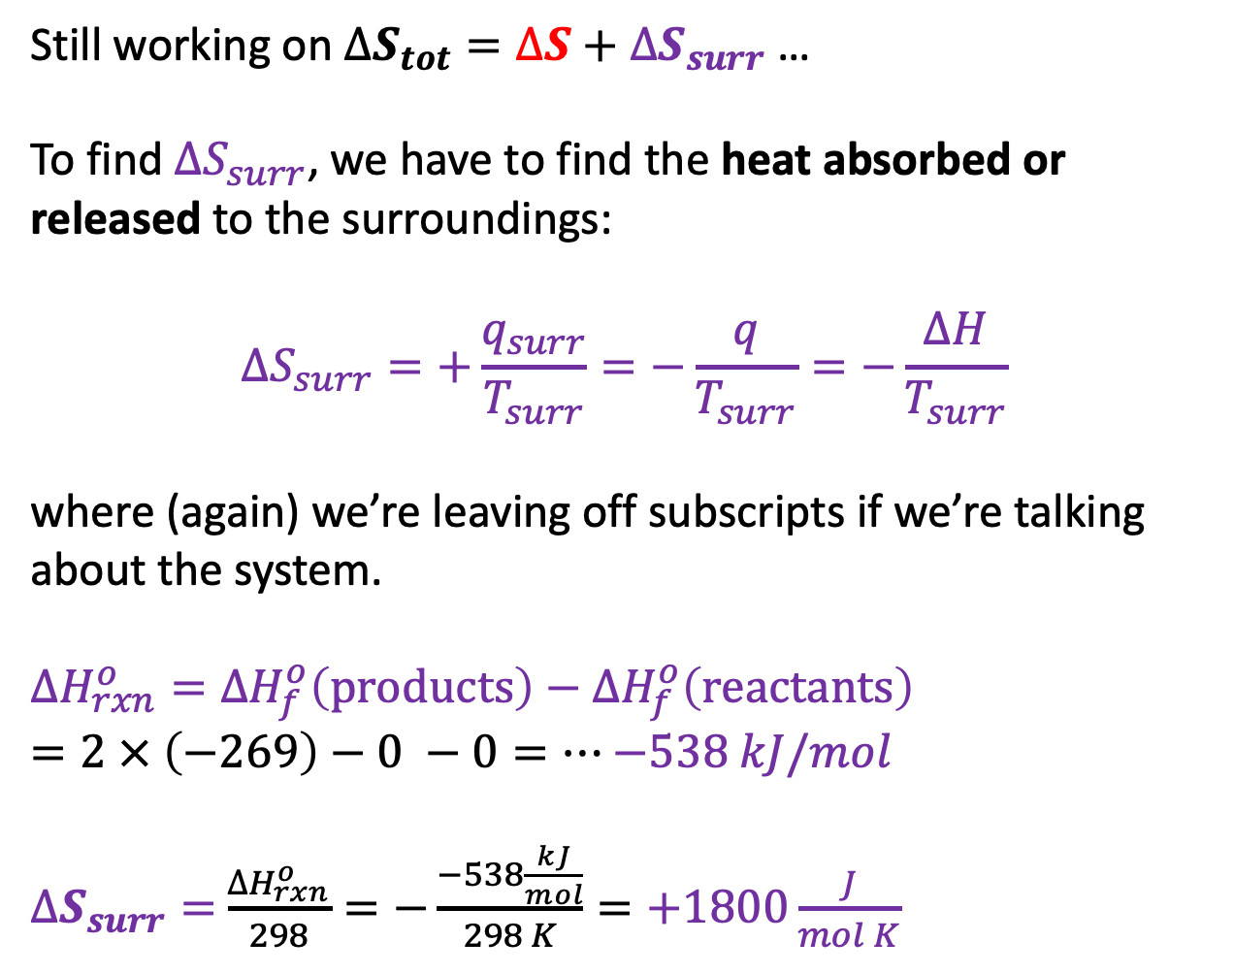
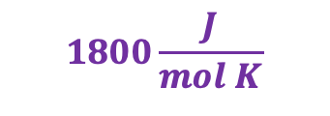
Thermodynamics of the reaction $H_{2}+F_{2}→2HF$
Still working on $∆S_{tot}=∆S+∆S_{surr}$ …
To find $∆S_{surr}$, we have to find the heat absorbed or released to the surroundings:
$$∆S_{surr}=+\frac{q_{surr}}{T_{surr}}=−\frac{q}{T_{surr}}=−\frac{∆H}{T_{surr}}$$
where (again) we’re leaving off subscripts if we’re talking about the system.
$∆H_{rxn}^{o}={∆H}_{f}^{o}\left(products\right)−{∆H}_{f}^{o}\left(reactants\right)$
$=2 × \left(−269\right)−0 −0=…$ $−538 kJ/mol$
$∆S_{surr}=$ $\frac{∆H_{rxn}^{o}}{298}=−\frac{−538\frac{kJ}{mol}}{298 K}=+1800\frac{J}{mol K}$
$$1800\frac{J}{mol K}$$
$$14\frac{J}{mol K}$$

Slide 11
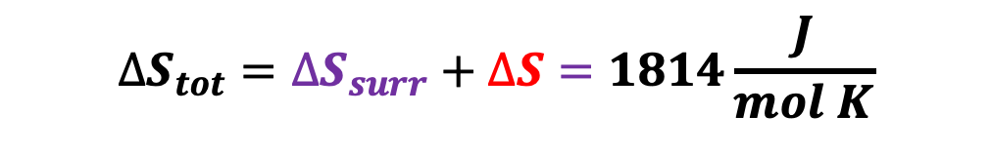
Thermodynamics of the reaction $H_{2}+F_{2}→2HF$
Still working on $∆S_{tot}=∆S+∆S_{surr}$ …
To find $∆S_{surr}$, we have to find the heat absorbed or released to the surroundings:
$$∆S_{surr}=+\frac{q_{surr}}{T_{surr}}=−\frac{q}{T_{surr}}=−\frac{∆H}{T_{surr}}$$
where (again) we’re leaving off subscripts if we’re talking about the system.
$∆H_{rxn}^{o}={∆H}_{f}^{o}\left(products\right)−{∆H}_{f}^{o}\left(reactants\right)$
$=2 × \left(−269\right)−0 −0=…$ $−538 kJ/mol$
$∆S_{surr}=$ $\frac{∆H_{rxn}^{o}}{298}=−\frac{−538\frac{kJ}{mol}}{298 K}=+1800\frac{J}{mol K}$
$$1800\frac{J}{mol K}$$
$$14\frac{J}{mol K}$$
$$∆S_{tot}=∆S_{surr}+∆S=1814\frac{J}{mol K}$$

Slide 12
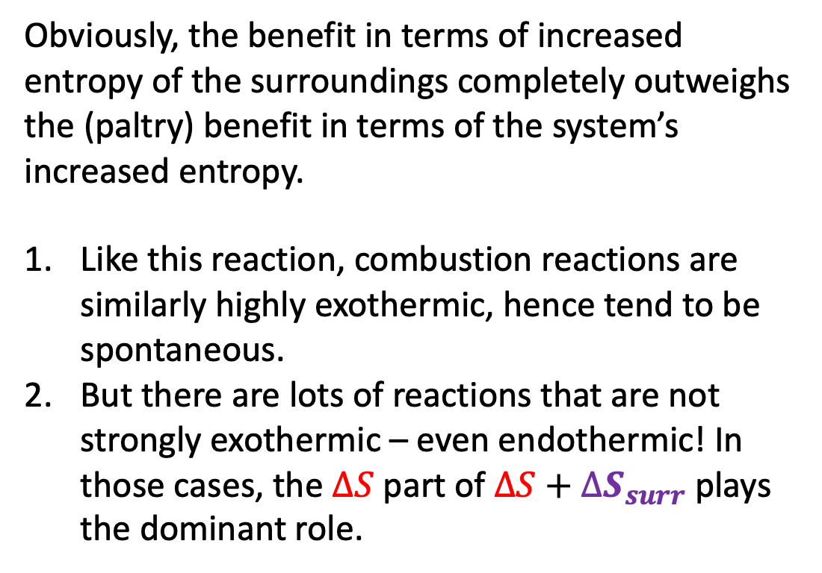
Thermodynamics of the reaction $H_{2}+F_{2}→2HF$
Obviously, the benefit in terms of increased entropy of the surroundings completely outweighs the (paltry) benefit in terms of the system’s increased entropy.
Like this reaction, combustion reactions are similarly highly exothermic, hence tend to be spontaneous.
But there are lots of reactions that are not strongly exothermic – even endothermic! In those cases, the $∆S$ part of $∆S+∆S_{surr}$ plays the dominant role.
$$1800\frac{J}{mol K}$$
$$14\frac{J}{mol K}$$
$$∆S_{tot}=∆S_{surr}+∆S=1814\frac{J}{mol K}$$

Slide 13
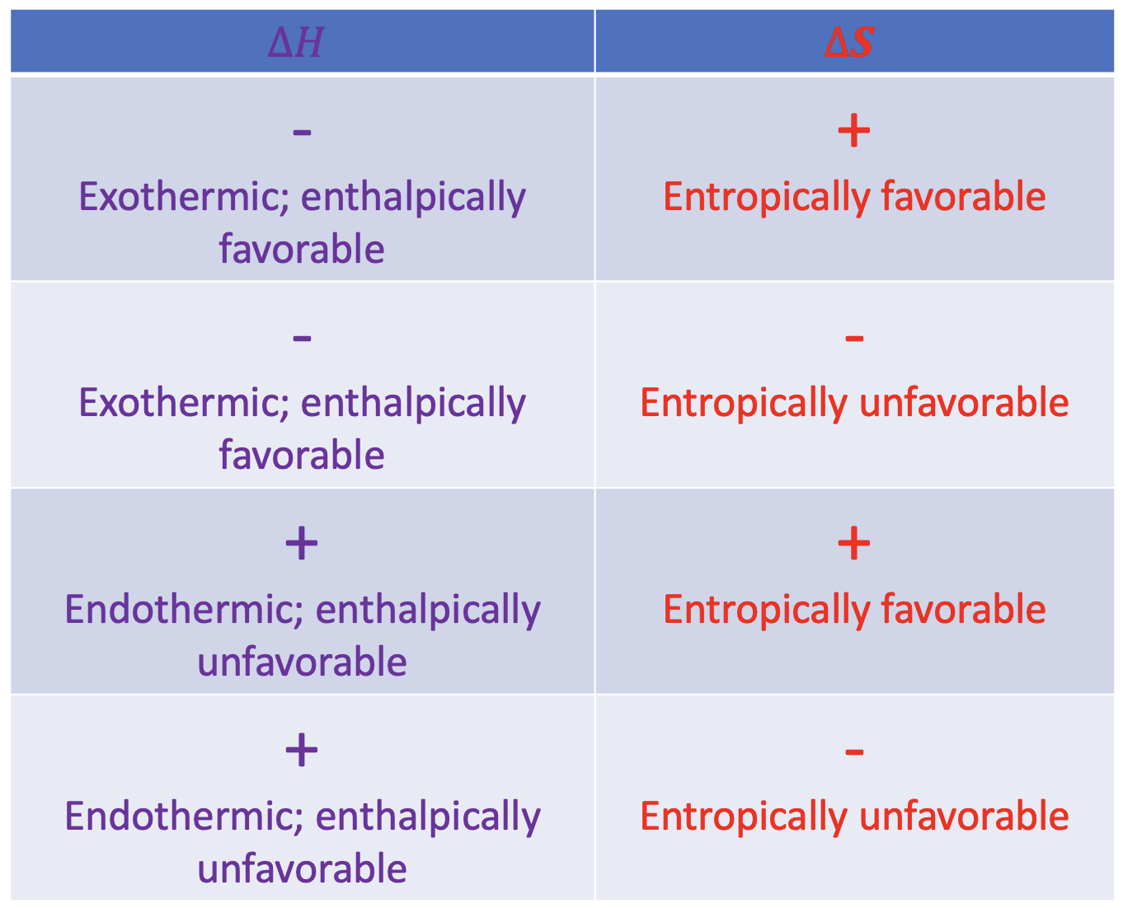
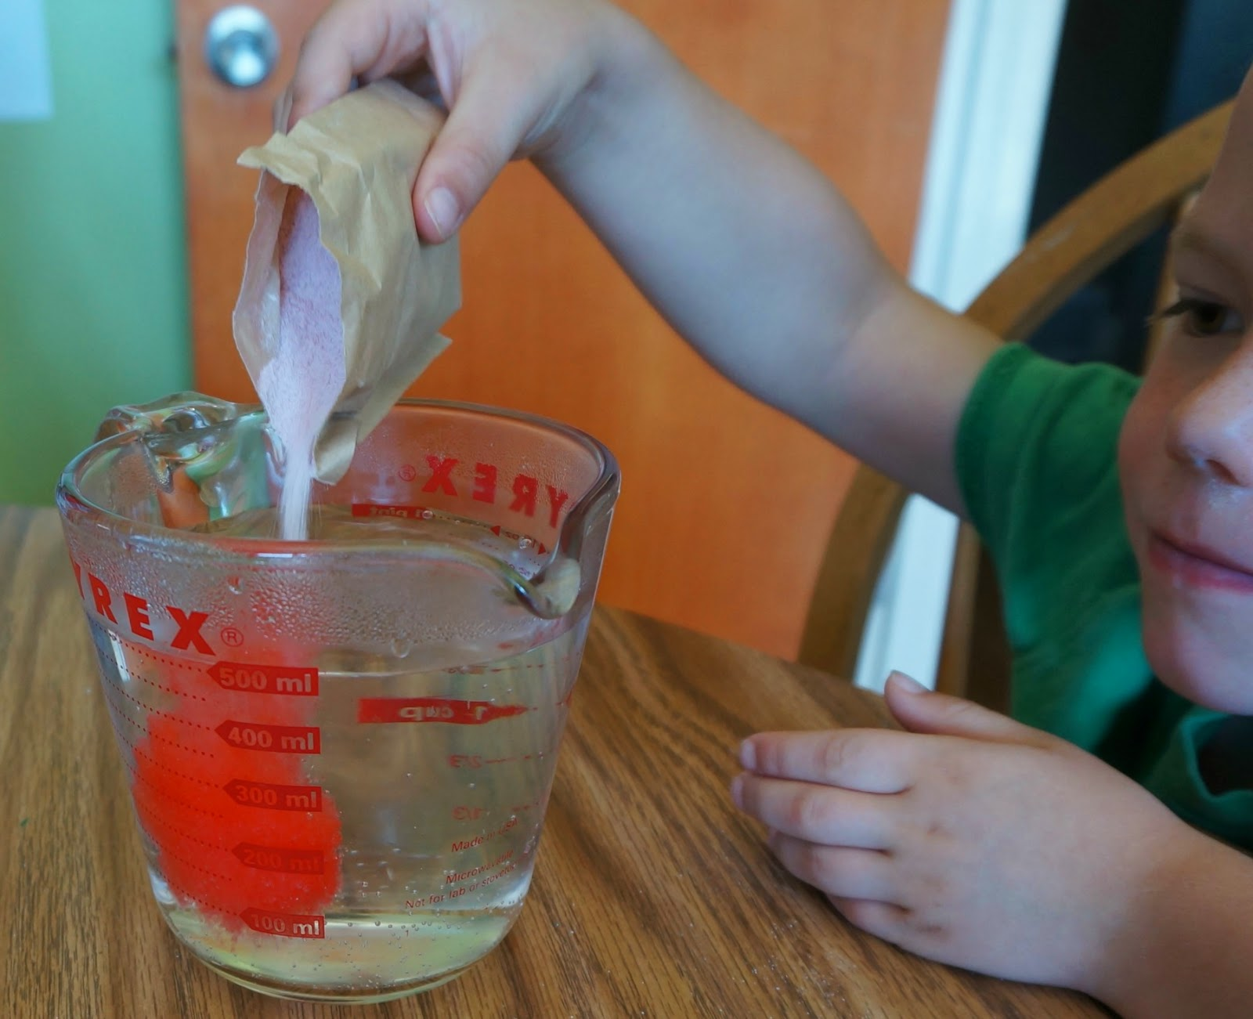










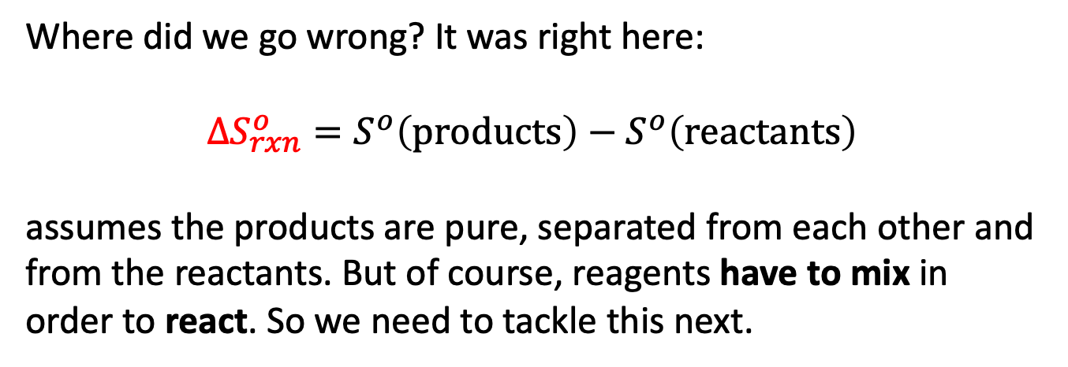


An important caveat: mixing
It turns out that this table omits something really critical. Remember we talked about irreversibility? Irreversibility happens whenever we mix different chemical substances.
Where did we go wrong? It was right here:
$$∆S_{rxn}^{o}=S^{o}\left(products\right)−S^{o}\left(reactants\right)$$
assumes the products are pure, separated from each other and from the reactants. But of course, reagents have to mix in order to react. So we need to tackle this next.
$H_{2}$
$H_{2}$
$H_{2}$
$H_{2}$
$$HF$$
$$F_{2}$$
$$F_{2}$$
$H_{2}$
$$HF$$
$$F_{2}$$
$$F_{2}$$
$$F_{2}$$
$$F_{2}$$

Slide 14
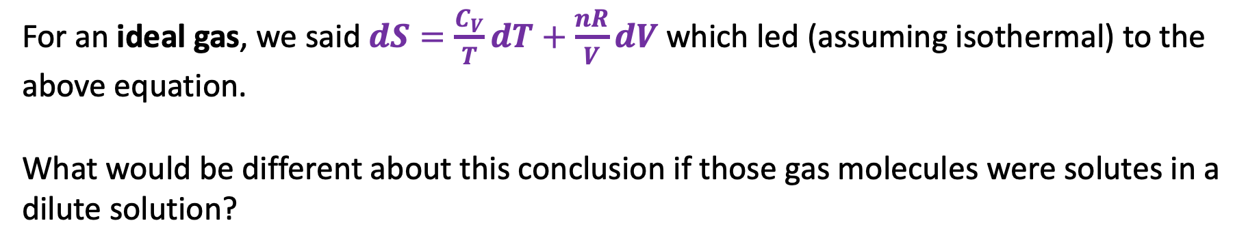

Taking a lesson from gases
$∆S=nRln\left(\frac{V_{f}}{V_{i}}\right)$
For an ideal gas, we said $dS=\frac{C_{V}}{T}dT+\frac{nR}{V}dV$ which led (assuming isothermal) to the above equation.
What would be different about this conclusion if those gas molecules were solutes in a dilute solution?

Slide 15

Entropy of dilution
$∆S_{dil}=nRln\left(\frac{V_{f}}{V_{i}}\right)$
For an ideal solute, we’ll say the same thing! (Still assuming isothermal). We’ll call this the entropy of dilution, $∆S_{dil}$.

Slide 16
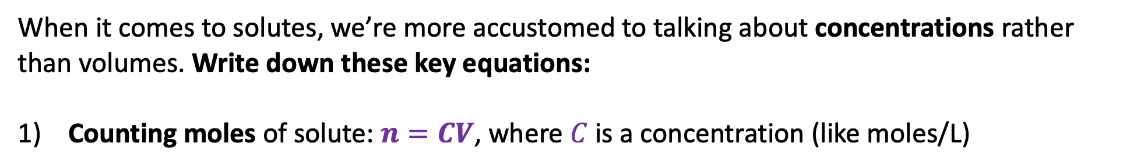
Entropy of dilution
$∆S_{dil}=nRln\left(\frac{V_{f}}{V_{i}}\right)$
When it comes to solutes, we’re more accustomed to talking about concentrations rather than volumes. Write down these key equations:
Counting moles of solute: $n=CV$, where $C$ is a concentration (like moles/L)

Slide 17
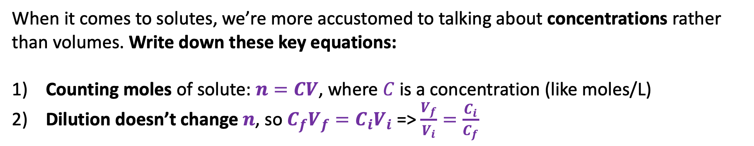
Entropy of dilution
$∆S_{dil}=nRln\left(\frac{V_{f}}{V_{i}}\right)$
When it comes to solutes, we’re more accustomed to talking about concentrations rather than volumes. Write down these key equations:
Counting moles of solute: $n=CV$, where $C$ is a concentration (like moles/L)
Dilution doesn’t change $n$, so $C_{f}V_{f}={C_{i}V}_{i}$ => $\frac{V_{f}}{V_{i}}=\frac{C_{i}}{C_{f}}$

Slide 18
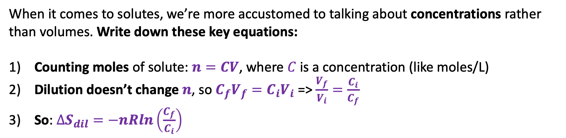
Entropy of dilution
$∆S_{dil}=nRln\left(\frac{V_{f}}{V_{i}}\right)$
When it comes to solutes, we’re more accustomed to talking about concentrations rather than volumes. Write down these key equations:
Counting moles of solute: $n=CV$, where $C$ is a concentration (like moles/L)
Dilution doesn’t change $n$, so $C_{f}V_{f}={C_{i}V}_{i}$ => $\frac{V_{f}}{V_{i}}=\frac{C_{i}}{C_{f}}$
So: $∆S_{dil}=−nRln\left(\frac{C_{f}}{C_{i}}\right)$

Slide 19
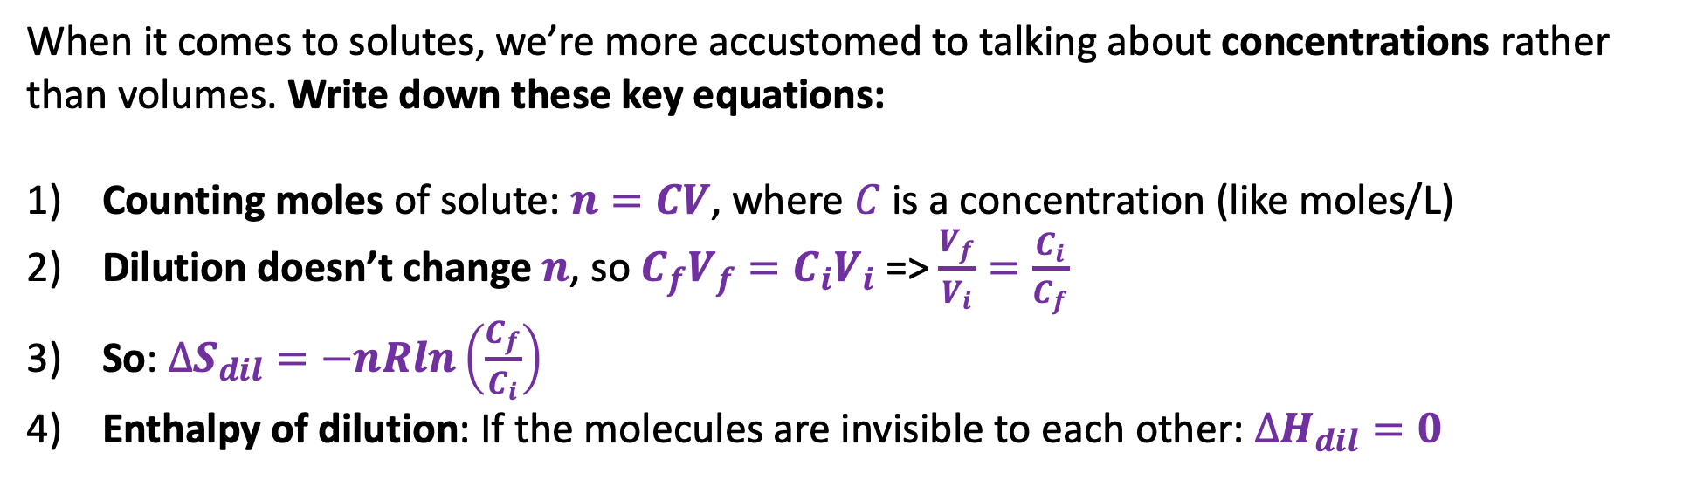
Entropy of dilution
$∆S_{dil}=nRln\left(\frac{V_{f}}{V_{i}}\right)$
When it comes to solutes, we’re more accustomed to talking about concentrations rather than volumes. Write down these key equations:
Counting moles of solute: $n=CV$, where $C$ is a concentration (like moles/L)
Dilution doesn’t change $n$, so $C_{f}V_{f}={C_{i}V}_{i}$ => $\frac{V_{f}}{V_{i}}=\frac{C_{i}}{C_{f}}$
So: $∆S_{dil}=−nRln\left(\frac{C_{f}}{C_{i}}\right)$
Enthalpy of dilution: If the molecules are invisible to each other: $∆H_{dil}=0$

Slide 20
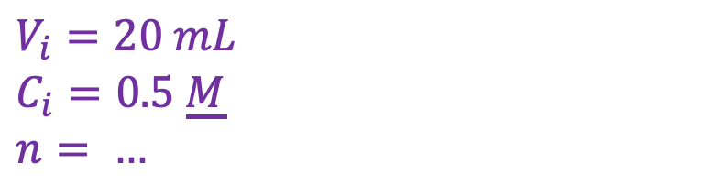
Examples (CGI) …
$$V_{i}=20 mL$$
$$C_{i}=0.5 \underline{M}$$
$$n= …$$

Slide 21
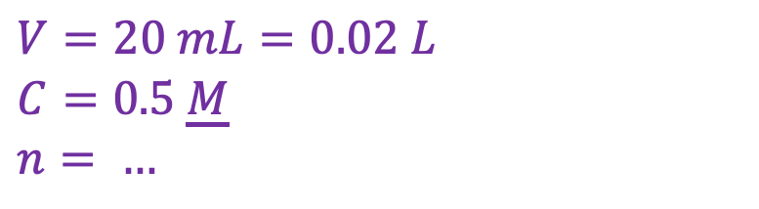
Examples (CGI) …
$$V=20 mL=0.02 L$$
$$C=0.5 \underline{M}$$
$$n= …$$

Slide 22
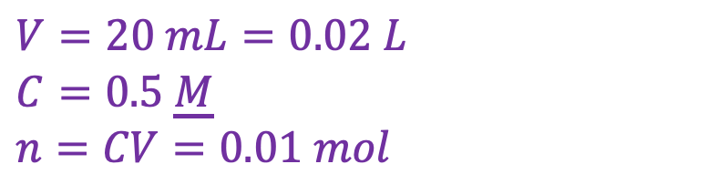
Examples (CGI) …
$$V=20 mL=0.02 L$$
$$C=0.5 \underline{M}$$
$$n=CV=0.01 mol$$

Slide 23
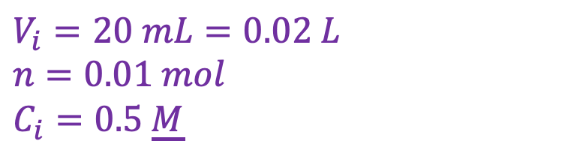
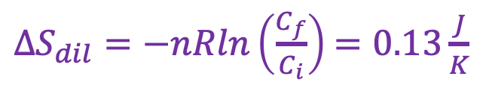
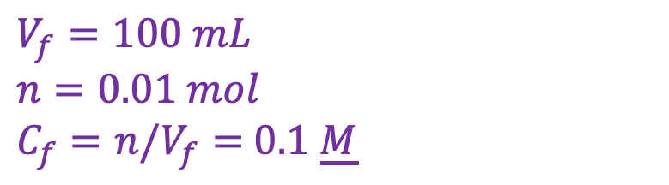
Examples (CGI) …
$$V_{i}=20 mL=0.02 L$$
$$n=0.01 mol$$
$$C_{i}=0.5 \underline{M}$$
$$V_{f}=100 mL$$
$n=0.01 mol$
$C_{f}=n/V_{f}=$ $0.1$ $\underline{M}$
$∆S_{dil}=−nRln\left(\frac{C_{f}}{C_{i}}\right)$ $=0.13\frac{J}{K}$

Slide 24
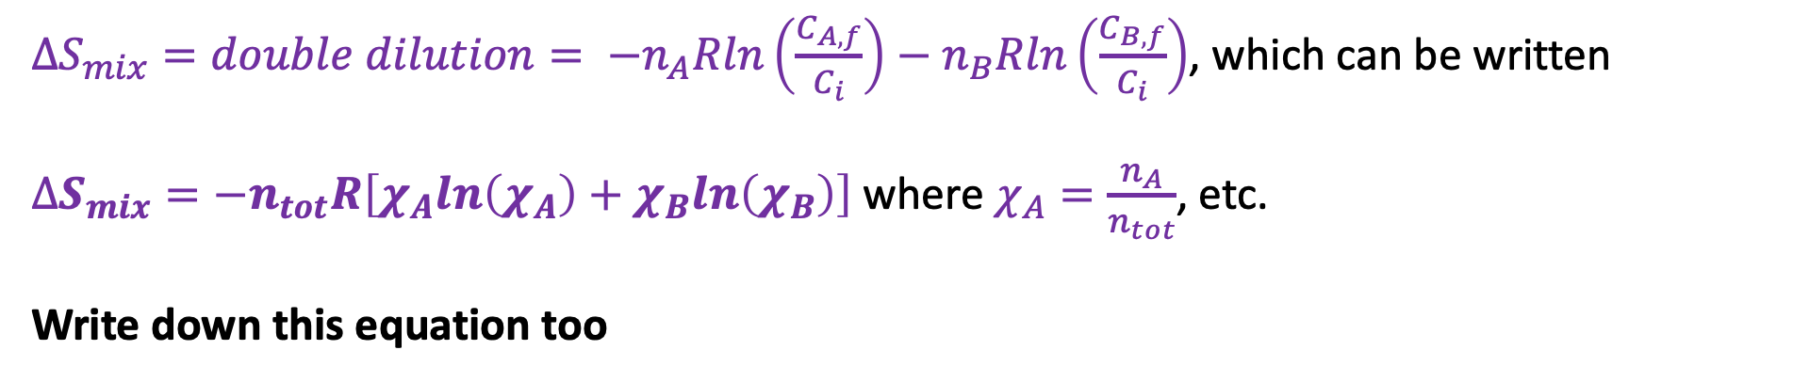

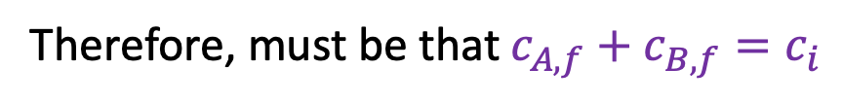



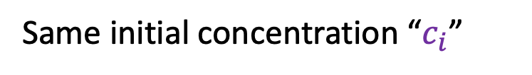
Entropy of mixing
$$n_{A}$$
$$c_{B,f}$$
$$n_{B}$$
$$c_{A,f}$$
Same initial concentration “$c_{i}$”
Therefore, must be that $c_{A,f}+c_{B,f}=c_{i}$
$∆S_{mix}=double dilution= −n_{A}Rln\left(\frac{C_{A,f}}{C_{i}}\right)−n_{B}Rln\left(\frac{C_{B,f}}{C_{i}}\right)$, which can be written
$∆S_{mix}=−n_{tot}R\left[χ_{A}ln\left(χ_{A}\right)+χ_{B}ln\left(χ_{B}\right)\right]$ where $χ_{A}=\frac{n_{A}}{n_{tot}}$, etc.
Write down this equation too

Slide 25
Example
$$∆S_{mix}=−n_{tot}R\left[χ_{A}ln\left(χ_{A}\right)+χ_{B}ln\left(χ_{B}\right)\right]$$
10 mL of A and 20 mL of B
(both 1 M solutions)
Let mix

Slide 26
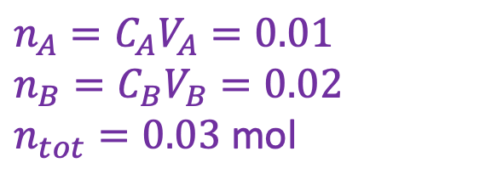
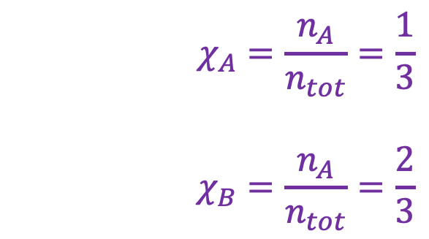
Example
$$∆S_{mix}=−n_{tot}R\left[χ_{A}ln\left(χ_{A}\right)+χ_{B}ln\left(χ_{B}\right)\right]$$
10 mL of A and 20 mL of B
(both 1 M solutions)
$$χ_{A}=\frac{n_{A}}{n_{tot}}=\frac{1}{3}$$
$$χ_{B}=\frac{n_{A}}{n_{tot}}=\frac{2}{3}$$
Let mix
$$n_{A}=C_{A}V_{A}=0.01$$
$$n_{B}=C_{B}V_{B}=0.02$$
$n_{tot}=0.03$ mol
$$∆S_{mix}=−0.03 R\left[\frac{1}{3} ln\left(\frac{1}{3}\right)+\frac{2}{3}ln\left(\frac{2}{3}\right)\right]≈+0.2\frac{J}{mol K}$$

